Slide 1
DEMO: How to set up and use AI agents to resolve basic data quality issues
Automating data quality with AI—delivering trusted, consistent, and explainable results at scale

Slide 2



Session Goal
This session starts a series of practical trainings on using AI Agents for data management.
Your CluedIn Trainer will demonstrate how to use the “Fix data quality issues” skill to resolve simple but common data quality issues.
We’ll start with basic data quality fixes and move on to more advanced use cases in the next sessions.
Note: This session is designed to develop practical experience with AI agents. For a full overview of AI agents, refer to the “CluedIn AI agents” session.

Slide 3


The data we’ll use
We are working with NorthStar Retail, a fictional international retailer. The challenge? The data is inconsistent and error-prone.
Customer data:
Invalid emails
Phone numbers in varied formats

Slide 4
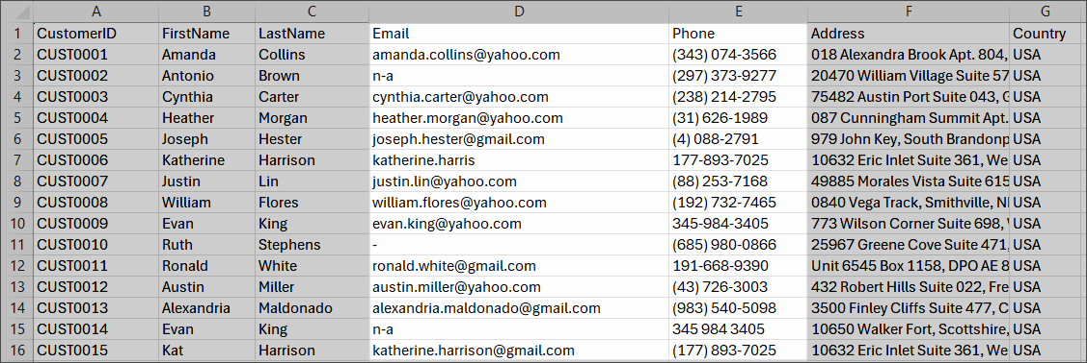

Slide 5
DEMO: How to set up and use AI agents to resolve basic data quality issues

Slide 6
Demo summary
You’ve seen how to:
Use AI agents to fix data quality issues
Interpret results and decide when to accept or reject them
Outcome:
You now understand how to leverage AI agents to effectively improve data quality at scale
Next step:
Pause the video and replicate the process.

Slide 7

Recommended materials
Before you get down to practice, make sure you are comfortable with ingesting and mapping data.
Ingest data | CluedIn Documentation
1.1. Ingestion | CluedIn Documentation

Slide 8
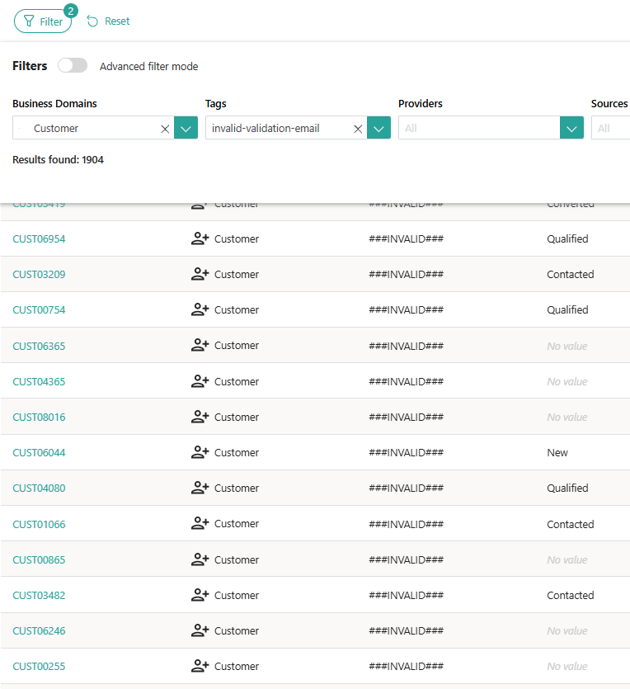


Learn more about AI agents in our documentation portal.
Next session: Using AI agents to deduplicate data.
What’s next?

